Slide 1



Todas
View in Power BI
Last data refresh:
29/03/2022 19:00:19 UTC
Downloaded at:
29/03/2022 19:11:02 UTC

Slide 2
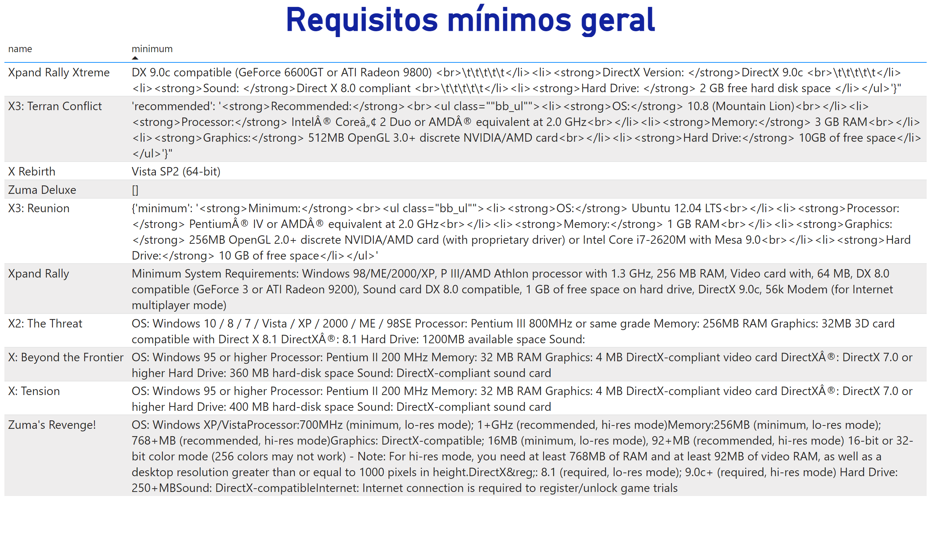
13- Requisitos mínimos geral
Notes:
textbox
No alt text provided
Requisitos mínimos geral
No alt text provided

